Slide 1
IBM Exploratory Data Analysis for Machine Learning Course Project
By Javier A. Jaime-Serrano
June 4th, 2021

Slide 2
Abstract
For this Project we used the Major Project dataset from the province of Alberta in Canada [1], it contains more than 700 currently active projects on the province, this Data set if filtered for Projects valued at $5 million or greater.
This Dataset contain a lot of valuable information on the Major Projects. The Estimated Cost, Sector & Type and the Location data will be used.
From this dataset, we will like to find the features that can predict the cost of the project for a given project type in a sector.

Slide 3
Data Cleaning
In order to prepare and clean the dataset:
We drop the projects where there is no estimated cost.
Made some assumptions about schedule completion and status.
Drop not required columns and renamed the remaining columns.
Made corrections on project types and sectors.
A problem encountered was how to extract the location coordinates (Longitude & Latitude) from a GeoJASON column. The problem was solved with Python code that loop over all rows and extract the start (first) locations by a type condition.

Slide 4
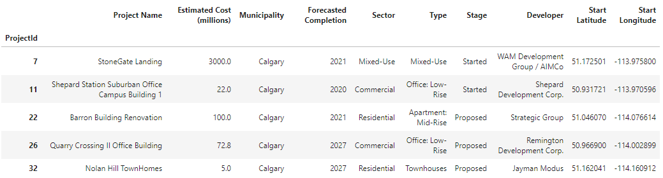
Data Cleaning
Figure 1. Cleaned Dataset

Slide 5
Data Exploration
We explored the data, first with descriptive statistics and bar charts (see Figure 2).
Second, we used box plots for the cost estimate ranges by type (see Figure 3).
Third, we used folium library to create a map using latitude and longitude values (See Figure 4).

Slide 6
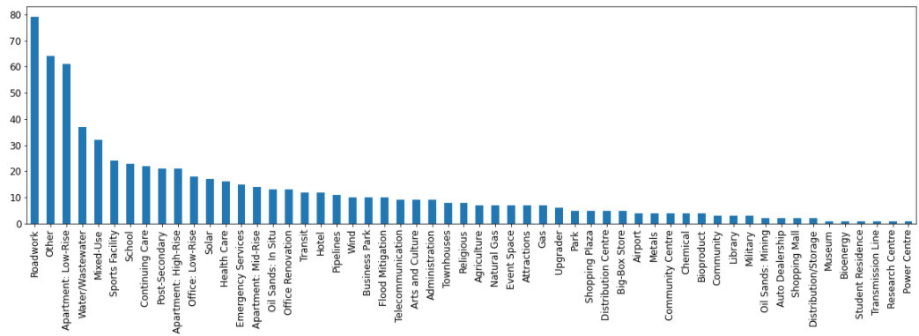
Data Exploration
Figure 2. Project types bar chart

Slide 7
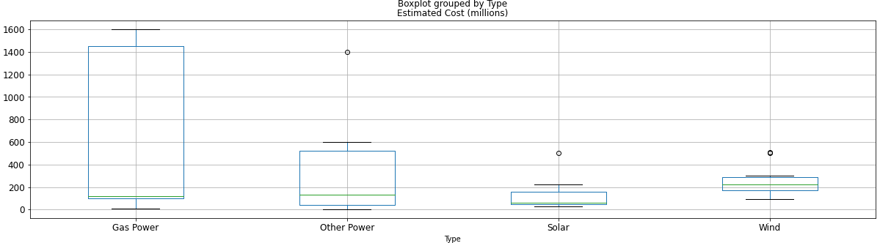
Data Exploration
Figure 3. Box Plot Estimated Cost for Power Sector

Slide 8
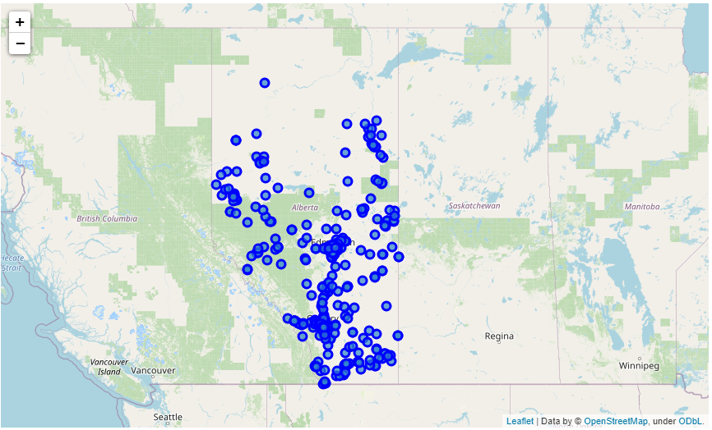
Data Exploration
Figure 4.
Projects Map

Slide 9
Key Findings and Insights
After corrections, we ended with 58 unique types in 9 sectors (see figure 6).
For the feature engineering, we extracted size and capacity data by type from the dropped project details column, adding units and cleaning it manually in excel.
A filter was set to remove extreme values, from a percentage range in relation to average cost, divided by capacity per type of projects, and labeled with conditional formulas in excel.
Only 97 projects were properly classified as “In the Range”, and Only 3 types has more than 10 Projects in this valid range.

Slide 10
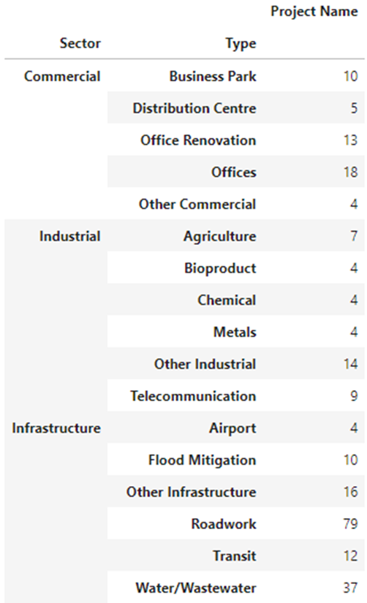
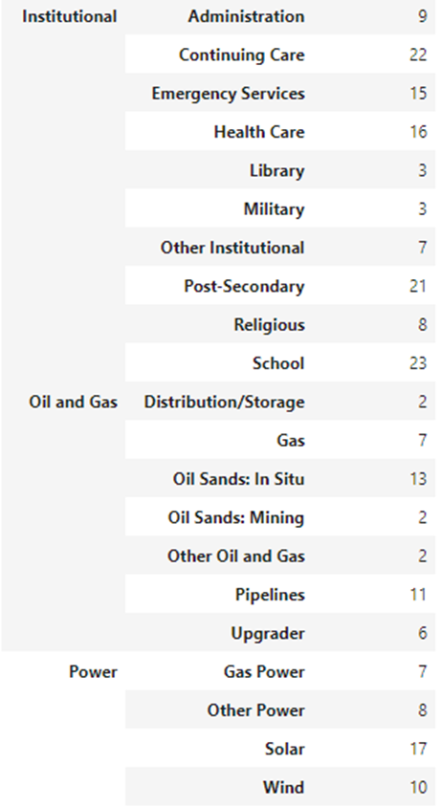
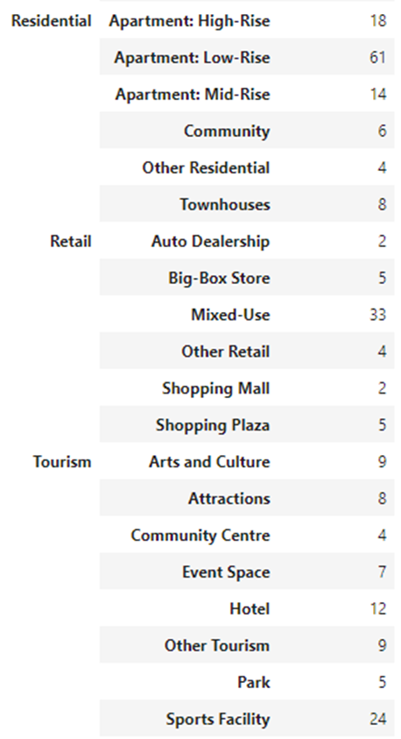
Findings
Figure 6.
Unique Sectors
and Types

Slide 11
Hypothesis formulation
We want to be able to estimate the cost of similar projects, with a rough order of magnitude (ROOM). In order to test the predictive features with correlation, we need first to pick a sector, for this case we choose the power sector (see figure 7).
Is Size/Capacity in Megawatts is correlated with the Estimated Cost?
State the hypothesis:
- Null Hypotesis (H0): Size/Capacity is not correlated with Estimated Cost
- Alternative Hypotesis (H1): Size/Capacity is correlated with Estimated Cost
Since they are both continuous variables we can use a pearson correlation test and draw a scatter plot (see figure 8).

Slide 12
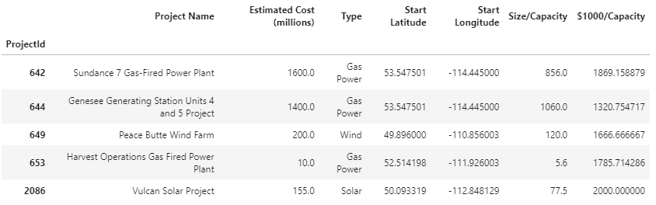
Hypothesis formulation
Figure 7. Power Sector Data

Slide 13
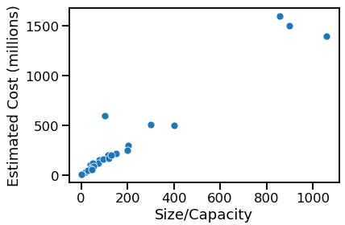
Hypothesis formulation
Figure 8.
Estimated Cost Vs.
Size/Capacity
Scatter Plot

Slide 14
Hypothesis formulation
A second hypotesis will be: Does Estimate Cost differ by Project Type?
An ANOVA test can be used for the Second hypotesis.
A third hypotesis will be: Is there is an association between Solar and Wind Project Types.
A T-Test can be used for the third hypotesis.
See figure 9 for the correlation by project type.

Slide 15
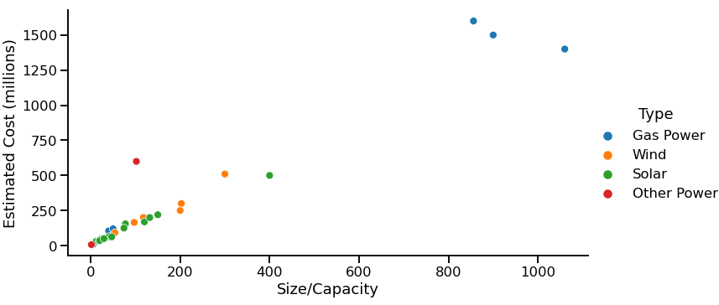
Hypothesis formulation
Figure 9. Scatter Plot by Project Type

Slide 16
Results
- Null Hypotesis (H0): Size/Capacity is not correlated with Estimated Cost
- Alternative Hypotesis (H1): Size/Capacity is correlated with Estimated Cost
Using the Pearson Correlation from SciPy we obtain:
Correlation Coeficient: 0.9676147594295178
Two-tailed p-value: 6.958427885850458e-19
Conclusion: Since the p-value < 0.05, we reject the Null hypothesis and conclude that there exists a relationship between Size/Capacity and the Estimated Cost.

Slide 17
Conclusions
Using the Major Project dataset from the province of Alberta, after preparation and cleaning, we were able to extract valuable but limited information.
After exploring the dataset, we were able to do some feature engineering and filter the data set to extract valid information.
We performed significance testing to prove the correlation between the Capacity in Megawatts in the Power Sector and the Estimated Cost.
Most of the projects has not enough data for the engineered features of size and/or capacity. Further work is required to search for capacity data from other sources (company websites, industry associations, etc.).

Slide 18
References
[1] Alberta Major Projects: https://majorprojects.alberta.ca/
[2] Scikit-learn library: https://scikit-learn.org/stable/
[3] Jupiter Notebook: https://github.com/javier-jaime/IBM-Machine-Learning-Capstone/

